Slide 1


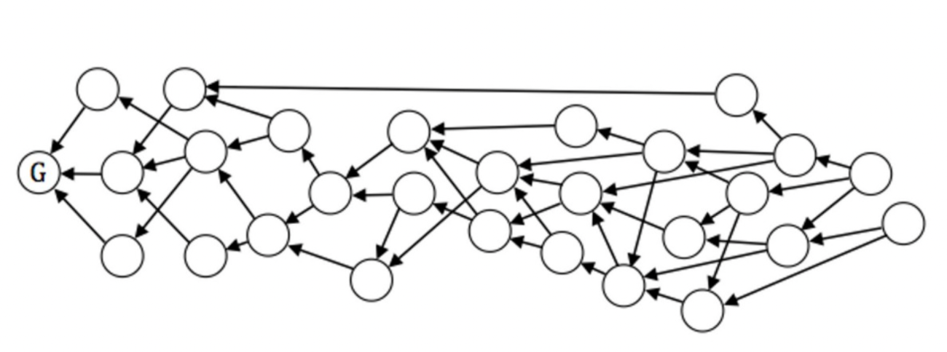
Robust data pipelines with Airflow using python
Davide Andreazzini

Slide 2

ABOUT ME
Davide Andreazzini
Italian 🇮🇹
Fullstack Developer at UruIT
Living in Uruguay 🇺🇾
Love Coding 💻
Love Cooking 🍕🍞🍝

Slide 3
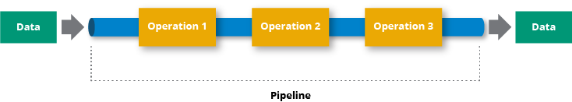
WHAT IS A DATA PIPELINE?
A data pipeline is a series of processing steps that is applied
to some data in a specified order.
A data pipeline is a software.
Common examples of data pipelines are:
ETL, Real Time analytics, web scraping, Model training,

Slide 4
SIMPLE DATA PIPELINE SCENARIO
Dave is a software engineer working for company A.
Company A contacts company B asking to send some revenue data.
They agree to send the data using SFTP.
Company A needs this data in a Database.
Dave is asked to create a data pipeline to handle this sync.
Dave thinks that a simple script and a CRON job should work.

Slide 5
LIVE CODING
https://github.com/david1983/pygeekle22-airflow

Slide 6
PROBLEMS OF A POOR IMPLEMENTATION
Company A asks Dave to backfill past revenue data
Company A asks Company B to send also user data alongside revenue data
Company A asks Dave a report on the daily execution of the pipeline
Company A asks Dave to backfill past week revenue data and user data
… more
Unspoken requirements
Lack of code reuse
Lack of testing
Lack of a development lifecycle
Lack of scalability

Slide 7
A DATA PIPELINE IS A SOFTWARE
And as every other software requires a development lifecycle.
Requirement analysis
Planning
Software Design / Architecture Design
Software Development
Testing
Deployment

Slide 8
APACHE AIRFLOW
Apache Airflow is a platform to build, schedule and monitor workflows.
Airflow gives to developer an opinionated way to create data pipelines removing the need to go through the entire software design / architecture design phase
As developers we do not want to reinvent the wheel.
We want to make the wheel smoother.

Slide 9
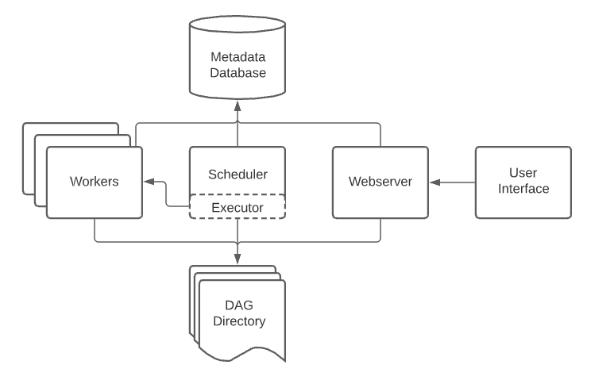
APACHE AIRFLOW ARCHITECTURE

Slide 10
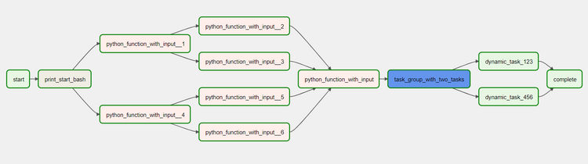
DAGS AND OPERATORS
Workflows are defined in Airflow as directed acyclic graphs (DAG).
The DAG is a collection of tasks and defines the relationships and dependencies of each of them.
The DAG describe how to run a workflow.
The Operator describe the task and what it should do.
The Operator run independently.
Airflow and the community around airflow provide already made operators.

Slide 11
SOME OF THE MOST USED OPERATORS
SimpleHttpOperator
BashOperator
PythonOperator
JdbcOperator
EmailOperator
S3{operation}Operator
…
Basically you can find an operator for every use case.

Slide 12
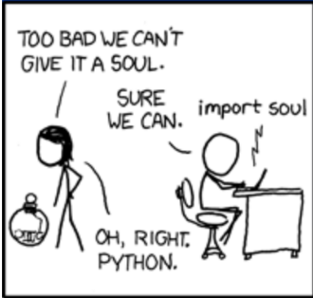
PYTHON OPERATOR
The PythonOperator is often used when there are no operators available, or when we want to run some bespoke python code.
Because Airflow it’s just Python it’s easy to plug in the entire Python microsystem, yes we give it a soul.
And because it’s Python we can use common development practices such as code versioning and testing.

Slide 13
SCHEDULING
Airflow takes care of scheduling the execution of the pipeline, no need for CRON jobs anymore.
When declaring the DAG we can define when the execution should be triggered via the schedule_interval property … and yes, if you really like CRON job notation you can express the interval in that format
We can also define a start_date in case we need to backfill from this date, or a end_date if we want to stop the execution of a DAG.

Slide 14
LIVE CODING
https://github.com/david1983/pygeekle22-airflow

Slide 15
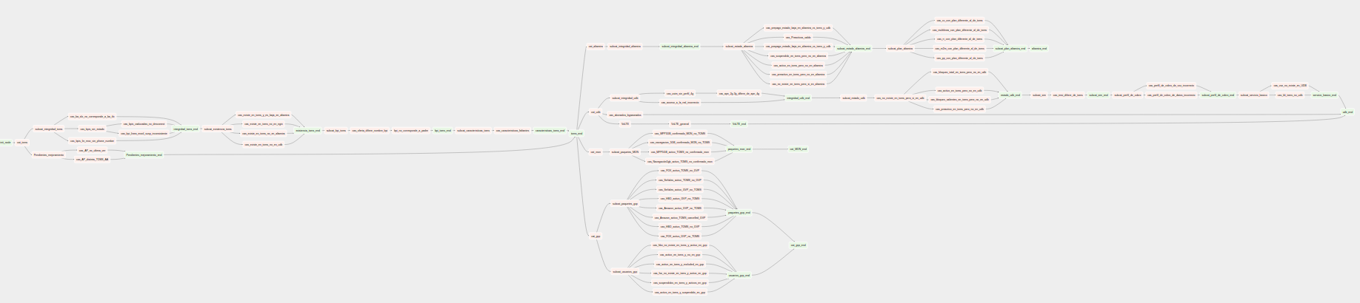
REAL WORLD EXAMPLE
As any other software system a data pipeline will start small and grow in complexity over time

Slide 16
CONCLUSION
If you want your data pipeline to be robust
Use scripts only for prototyping
Do not reinvent the wheel
Use proper software development lifecycle
Testing, testing and testing

